Slide 1
Mental Health in the Workplace

Slide 2
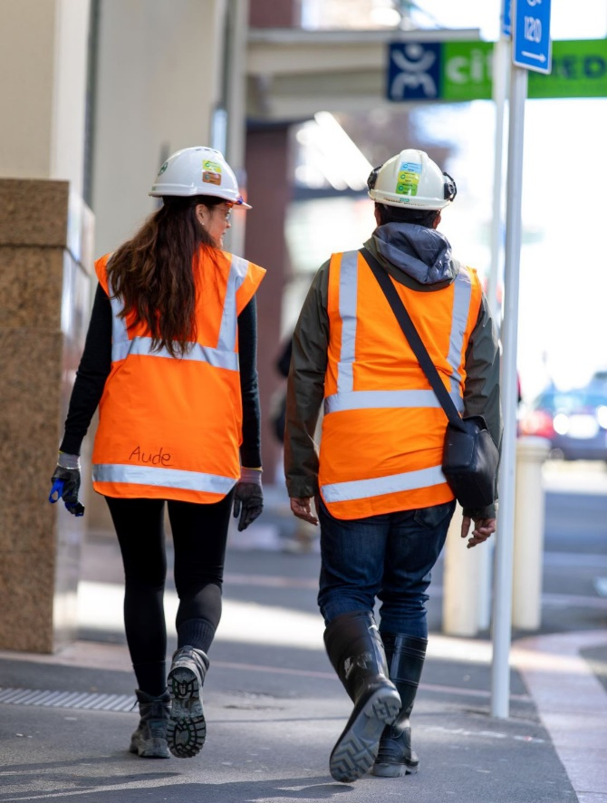
Mental Health Issues Are Common
In New Zealand one in five people over 16 years of age experience some form of common mental health issue in any one year and almost two in every five adults have experienced a mental health issue over their lifetime.
Notes:
Mental Health issues are common. This can be anything from low levels of anxiety to medically diagnosed depression.

Slide 3
Stress
Pressures of work, either actual or perceived.
Unexpected responsibilities, timelines.
Excessive working hours, lack of sleep.
External pressures, family, social, mental health
Notes:
A lot of mental health issues are associated with stress. Pressures can be self imposed, work related or from non-work related pressures such as family, health issues etc.

Slide 4
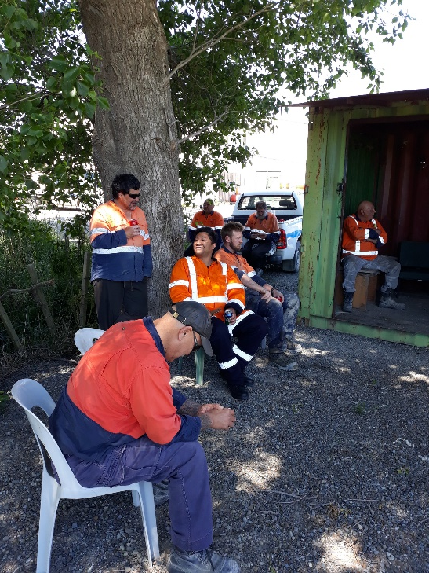
Right now, you or someone in your workplace is likely to be affected
Talk - about mental wellbeing: Make talking about wellbeing an everyday thing. Keeping the kōrero (chat) alive and open in your workplace positively affects mental wellbeing.
Don’t ignore it
You need to be empathetic, approachable and willing to listen
No special skills are required to talk about mental health
Notes:
It is important that we don’t ignore any signs of mental health issues in the workplace. Talking about mental wellbeing is important. Keep the dialogue up and workers will be happy to talk about issues when they arise.

Slide 5
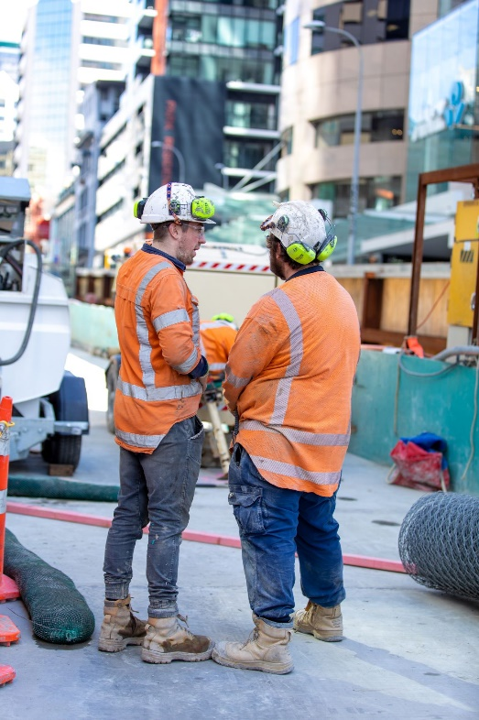
Right now, you or someone in your workplace is likely to be affected
Understand - what is supportive:
To find out how you can support, listen non-judgmentally.
Acknowledge the person’s feelings and don’t take them personally.
Let them know you’re asking because you’re concerned about them.
Most importantly take what they say seriously.
Notes:
You need to be empathetic toward people experiencing mental health issues and try to understand what they are going through. It is important to listen, take them seriously and acknowledge the persons feelings.

Slide 6
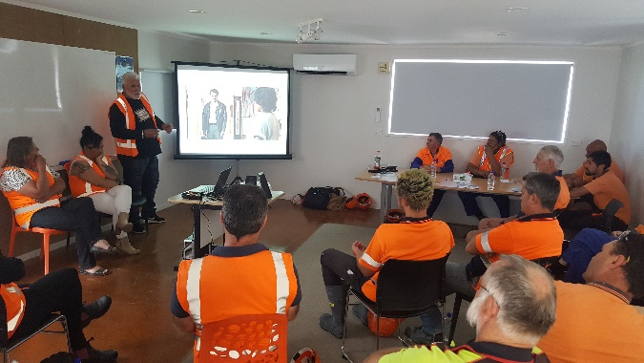
Right now, you or someone in your workplace is likely to be affected
Work together - for shared success:
Work together to find solutions that work for both you and your workers, keeping the mana of everyone intact.
Focus on strengths and abilities brought to the workplace and what resources you can both bring to tautoko (support) wellbeing and achieve shared goals.
Remember to follow up in a few days.
Notes:
Support each other. Working together will give all of us strength to work through whatever issues are impacting on mental health. Just because it is not impacting you directly this time, it might next time.

Slide 7
Where to get help
WorkSafe
Employee Assistance specialists
MinEx - wayne@minex.org.nz
mobile: 021 944 336
IOQ
HSMS training for small operations
Fit-for-purpose regulations
Codes of Practice
Notes:
There are places where you and your fellow workmates can get help. Don’t be afraid to ask.

